Slide 1
Artificial intelligence
26-11-2019
By Venkatesh

Slide 2
Agenda
Introduction
Machine Learning
Applications of ML
Types Of Machine Learning
Q & A

Slide 3

Introduction
AI is the science and engineering of making intelligent machines, especially computer programs.
Notes:
The term Artificial Intelligence comprises of two words ‘Artificial’ and ‘Intelligence’, where, Artificial means ‘copy of something natural’ and ‘Intelligence’ means ‘able to think.’
So, Artificial Intelligence can be defined as a copy of a human brain with thinking ability.

Slide 4
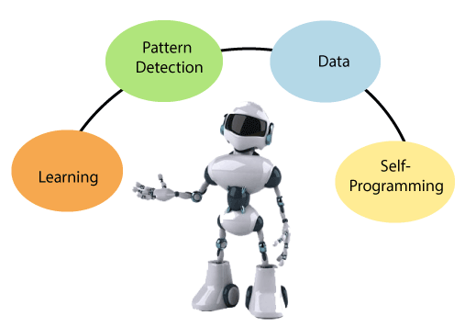
Machine Learning
“Machine learning uses statistical tools on data to output a predicted value. It is an application of artificial intelligence that provides the system with the ability to learn and improve from experience without being explicitly programmed automatically”.
Notes:
Traditional Programming = Data and program , it will give output
ML = Provide Input data and output , it generates logic by its own.

Slide 5
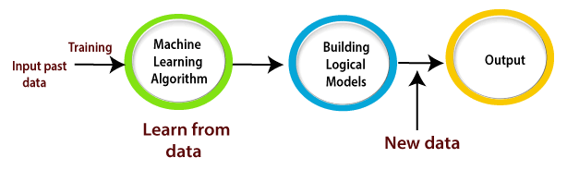
Working of Machine Learning

Slide 6
Applications of ML
Alexa
Google Maps and Google Assistant
Image recognition
Speech recognition
Fraud detection and its prevention
Product suggestions on online shopping
Diagnosis of medical issues
Traffic prediction
Notes:
Diagnosis = Checking if person is diabetes
Product suggestion = association

Slide 7
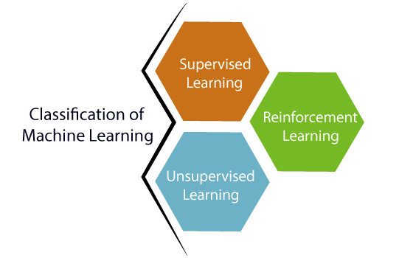
Types of ML

Slide 8
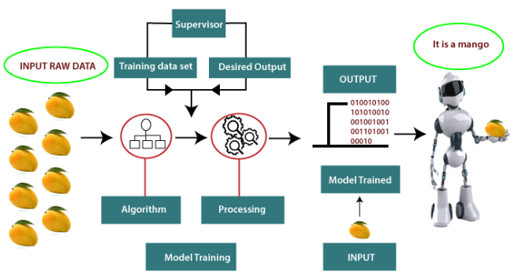
Supervised Learning
Notes:
Supervised learning is the one done under the supervision of a teacher or a supervisor. Basically, the model is trained over a labeled dataset. A labeled database is one which contains both inputs as well as the output parameters. Here the trained dataset act a teacher, and its primary role is to train the model. The prediction is made once the model is built. It works in the same manner as the student learns under the supervision of the teacher.

Slide 9
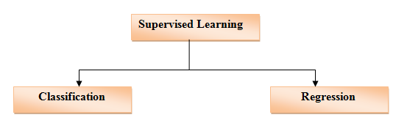
Types of Supervised Learning
Notes:
Classification: – Classification based algorithms are used whenever there is some certain (discrete value) output variable, i.e., either Red or Blue, Yes-No, Male-Female, 0 or 1, etc. The real-world example would be spam filter.
Regression: – The regression-based classification method is used for the prediction of continuous values, especially in the case when the input and output variables are related to each other. It focuses on calculating a value closer to the output value. It is employed in weather forecasting etc.

Slide 10
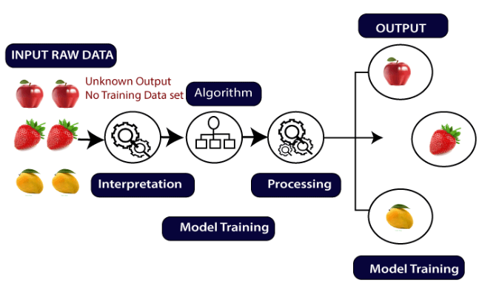
Un-supervised Learning
Notes:
It is a kind of learning in which the output target is not given to the model while performing the training. It only has the input variables. The model has to lean itself. The trained data that is fed to the system can be unlabeled as well as unstructured in nature.
The unstructured data is the one where the noise or some irrelevant information is present, whereas in case of unlabeled data it does not contain any target value other than the input data and is easy to collect as compared to labeled one in the supervised learning.

Slide 11
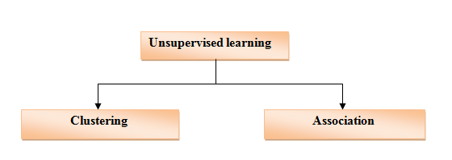
Types of Un-supervised Learning
Notes:
Clustering is a technique in which the model groups the data based on different patterns, whereas in the case of association; it is a rule-based technique. It is used to find out the relevant relationship between the parameters of a dataset.

Slide 12
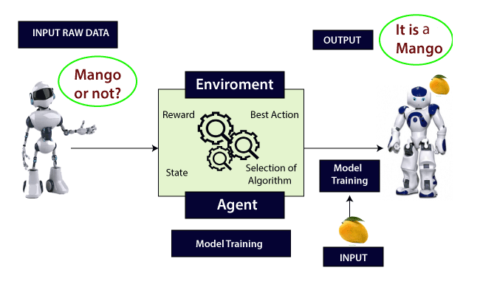
Reinforcement learning
Notes:
In this type of learning, the agent connects with the environment and searches for the best outcome. It is a hit and trial method. Based on the result, the author may be either rewarded or penalized for every wrong and correct answer. The more the positive rewards points gained, the more the model can train itself. And the prediction is made after getting trained entirely.

Slide 13

Thank you

